Slide 1
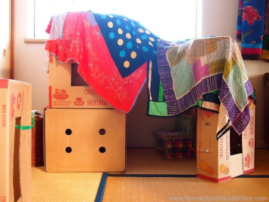
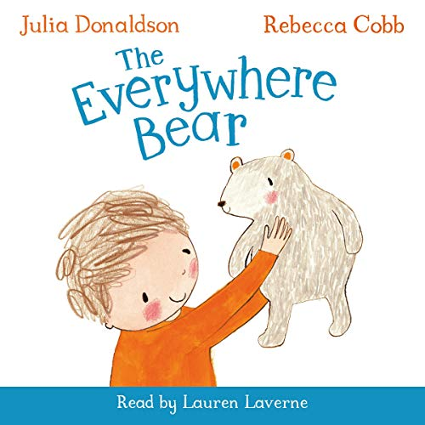
Starting school with Charlie Bear
Make a den.
Using cushions, quilts, blankets etc build a den for you and your teddy.
Learning
Problem solving skills
Listening skills
Building vocabulary
Developing creativity.
Write your own story
With the help of an adult can you make up a short story about your Teddy Bear’s journey to the stars. How did your bear travel? What did they see on the way?
Learning
Recall and planning skills needed for recording experiences, ideas, feelings and information.
Communicate my experiences, thoughts and ideas.
Explore characters and events in stories which help me invent my own.
Make a den like Daisy.
Using cushions, quilts, blankets etc build a den for you and your teddy.
Learning
Problem solving skills
Listening skills
Building vocabulary
Developing creativity.
Week 1
Finding Information
The seagull helped Everywhere Bear find the children again. Can you find any interest information about Seagulls? Where do they like to live? What do they eat? Do you see them in your garden? Can you count how many come into your garden in 30mins?
Learning
Listen or watch for useful information.
Developing an interest in my environment.
Numeracy and recording skills.
‘A child who reads will be an adult who thinks.’
Unknown Author
https://www.youtube.com/watch?v=RkjQe6Gz1Ak

