Slide 1
Primary 1 Welcome Meeting Tuesday 27th September 2022

Slide 2
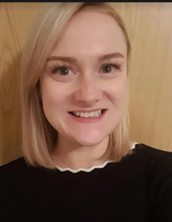
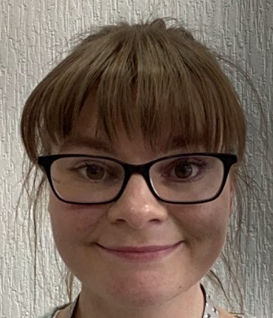
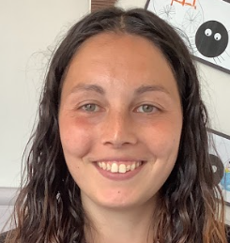
Meet the P1Team
Mrs Matheson
teaches P1a
Miss Hogg
teaches P1b
Mrs Mitchell
teaches P1b
Mrs Johnston
teaches P1c
Mrs Cunningham is a
Learning Assistant in P1
Miss Wilson is a
Learning Assistant in P1
Mrs McClean is a
Learning Assistant in P1
Mrs Corbett is a
Learning Assistant in P1

Slide 3
Other staff working with P1
Mr Peacock will teach P1a and P1c on a Monday afternoon.
Mrs Perry will teach Music on a Tuesday and Friday.
Mrs Mitchell will teach P1b on a Thursday.

Slide 4
Curriculum for Excellence
This is a simple guide showing how children may move through the levels of CfE. All children progress at their own pace and work is differentiated to support their learning.

Slide 5
Vision and Values
Kind Fair Hardworking Confident Respectful Responsible

Slide 6
School Improvement Plan 2022 - 2023
Priority 1 Improvement in attainment and achievement (literacy and numeracy).
Priority 2 Included, Engaged and Involved: Wellbeing and Equity
Priority 3 Use of digital technology to support learning
Learners have the right to a good quality education.
(Article 28, UNCRC)
Respectful, Kind, Hardworking, Responsible, Confident, Fair

Slide 7
Health and Wellbeing
We will be focussing on:
Building Resilience Programme
Wellbeing Indicators
2x hours of PE each week.
Relationships, Sexual Health and Parent Hood
Zones of Regulation

Slide 8
Literacy
RWInc
Handwriting
1x extended writing lesson per week
Listening & Talking, including Talking Ted
Play based learning
Your child will receive a sheet which supports the practising of learning to read and write each new sound. They will get this each day that they learn a new sound. Talking to your child about their sounds will support them in consolidating their learning.
Reading books will be sent out weekly at the end of term 2/ beginning of term 3. These will also be used in class.

Slide 9
Numeracy and Mathematics
We follow a skills based progression program in line with the Curriculum for Excellence. This includes: number word sequences and numerals, number structures and place value, addition and subtraction, multiplication and division and fractions.
Play based learning
Maths input
Outdoor learning to learn new skills and consolidate existing learning.
Learners will soon be receiving a “Blast Off with Numbers” pack. This will contain different materials and ideas for games to support the learning of numbers at home.

Slide 10
Learning Contexts
This year in P1, our learning contexts will be based on play based learning. This will involve both child initiated and adult led play experiences to cover and consolidate skills within the Curriculum for Excellence.
Why Play?
Through play, a child develops their
cognitive, social, emotional and
physical capacities.
Article 31 of the UNCRC- Every child has
the right to play.
Developmentally Appropriate

Slide 11
Learning Across the Curriculum
This year in P1, we will be using play based learning to develop the following curricular areas:
Expressive Arts
Science
Social Studies
Technologies
RME
We will use topics to allow us to explore certain areas in further detail. For example, this term our topic is “All About Me”.

Slide 12
Home Learning
In Primary 1, we have a class bear which is sent home at points across the year.
An act of kindness for someone. | Play your favourite game with me. | Lets bake or cook together.
Take me to find bugs or insects. | Let’s build something cool! | Lets take a selfie with our funniest faces!
Take me shopping. | Read a book together. What was your favourite part of the book? | Design me a new outfit.
Take me for a ride on your bike or scooter. | Movie time! | Take me for a walk.
Lets do some chores together! Can I help you to tidy your room? | Show me your hobbies and interests! | Lets be artists together. We an draw, paint or colour!

Slide 13
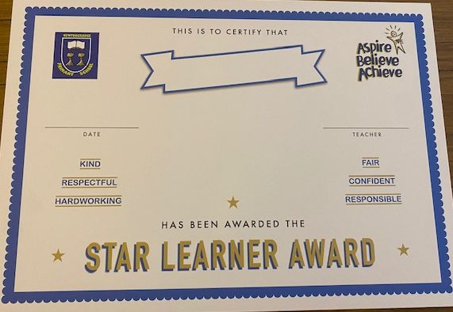
Communication
Examples
Parents Consultations – October and March
Written Report – June
Learner’s curriculum pathways
Snapshot of learning – Seesaw
Sharing the learning events
Good News Notes, Star Learners and Achievement Award
Assemblies

Slide 14
Sharing our learning and school news
All school information will be communicated to families via our school app and website. Please check regularly for updates.
http://newtongrange.mgfl.net/
Also please follow our school twitter page where we share our learning and achievements.
@NewtongrangePS
School App
QR Code

Slide 15
Reminders…
Children should bring their reading books and homework bags to school every day. We will only send these home on the days that there are letters or homework.
Coats or jackets should be coming to school everyday. The Scottish weather can be unpredictable!
All personal belongings should be named.
Children are encouraged to bring in a named water bottle into school everyday.
On PE days, learners should arrive at school in their sportswear.
Please inform us of any changes to the adult who will be collecting your child from school to help us ensure their safety.

Slide 16
What we are looking forwards to about P1
“Doing more writing”- Amelia
“Learning more numbers”- Aaron, Ellie & Kara
“Painting”- Emilie
“Listening to stories”- William
“Learning a new letter every day!”- Jamie & Lucas
“Playing schools with all of the loose parts”- Zoe
“Drawing”- Olivia
“Working hard!”-Emma

